Slide 1






How Stochastic Storm Simulation Can contribute to Flood Risk Adaptation Strategies in the Sahel
*
Vischel T.*, Miller J. ▲, Panthou G.*, Tazen F., Karambiri H. , Visman E. ▲, Sané Y. , Taylor C. ▲ , Wilcox C.*, Coulibaly , Gonzalez P. ▲, Body R. ▲, Vesuviano G. ▲, Bouvier C.°, Chahinian N.°, Cazenave F. *, Stratton R. ♦
▲
°
■
●
♦
SWGEN 2025 - Conference on Stochastic Weather Generators 2-4 Dec 2025 Grenoble (France)

Slide 2













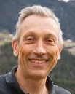

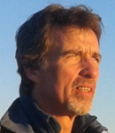


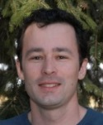




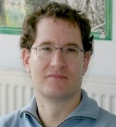



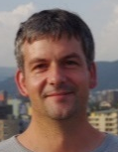

Institute of Geosciences and Environment
Research & Collaboration
with West Africa
~20 permanent researchers
Climate & Energy
Climate &
Water cycle
Hydrology & Critical Zone
Data sciences
A. Diedhiou
S. Anquetin
C. Lavaysse
N. Philippon
T. Lebel
T. Vischel
J-P. Vandervaere
B. Hector
J-M. Vouillamoz
T. Pellarin
V. Chaffard
B. Hingray
S. Rome
J. Blanchet
S. Bigot
G. Panthou
J-M. Cohard
M. Boucher
G. Favreau
B. Le Rubrus

Slide 3
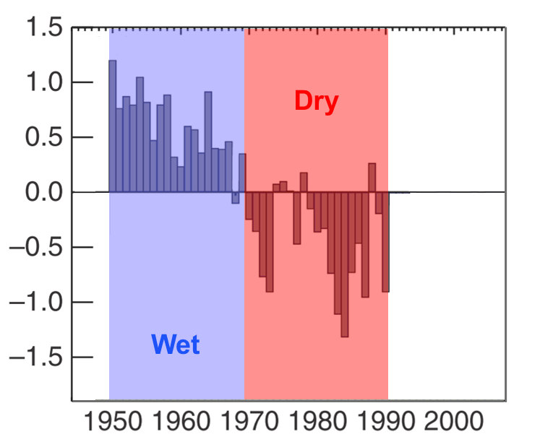


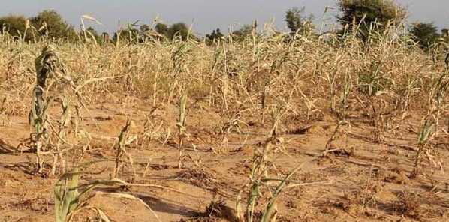
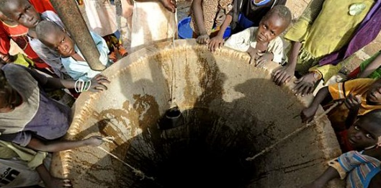
Food security
Droughts
Water ressources
Climate &
Water cycle

Slide 4
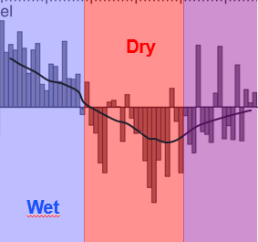
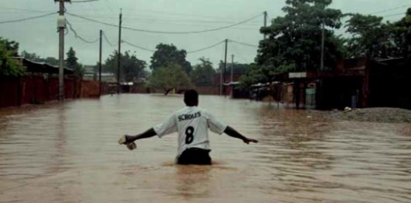


Food security
Droughts
Water ressources
Water cycle
Intensification
Flood damages
Extreme Storms
Floods

Slide 5
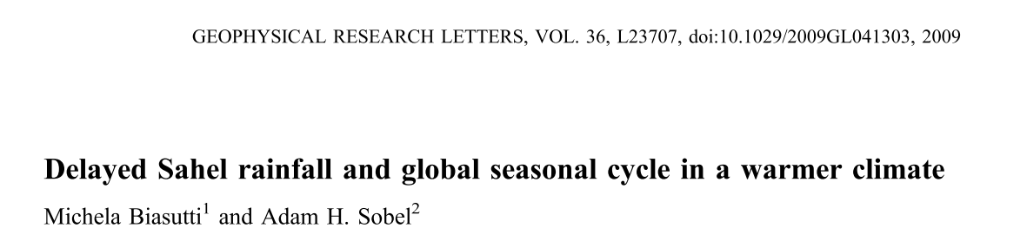
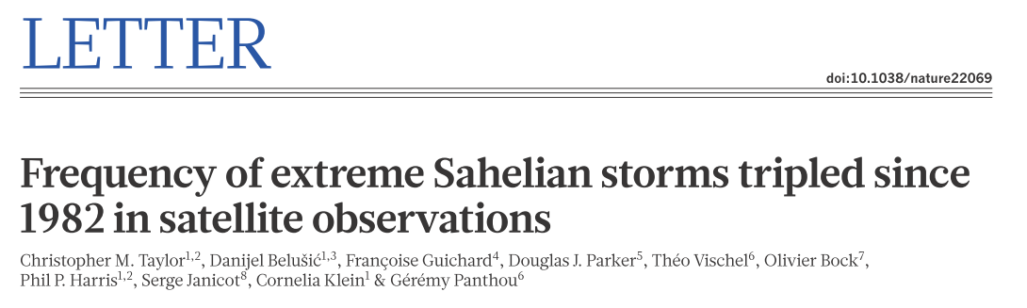

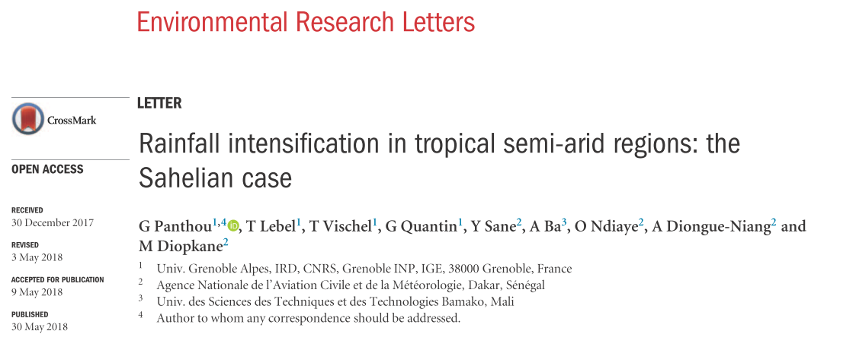
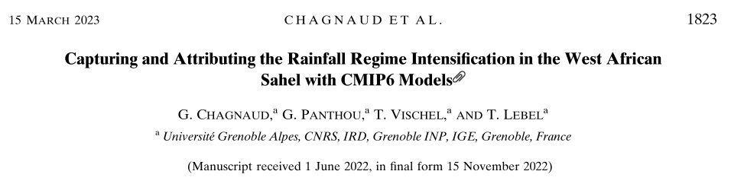
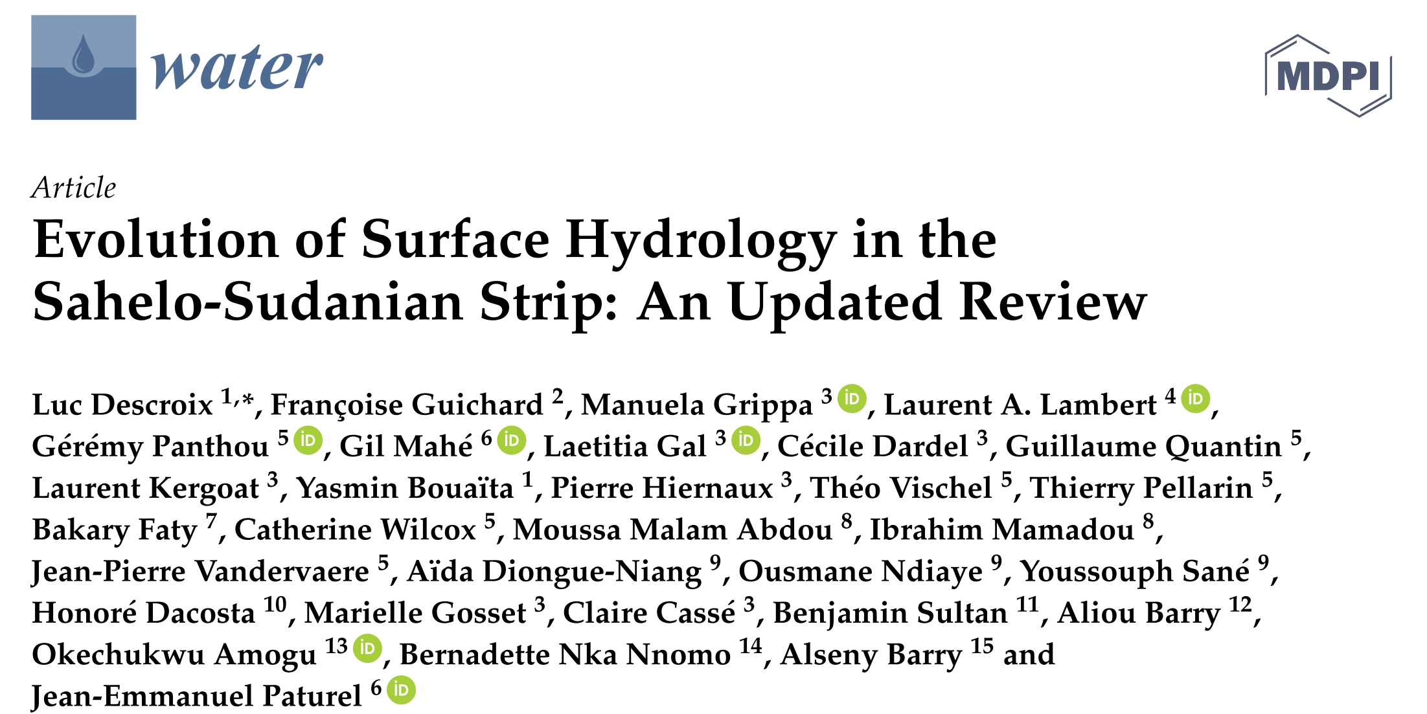
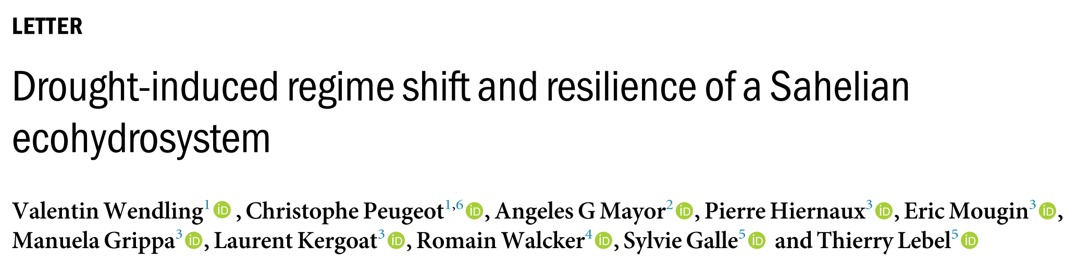
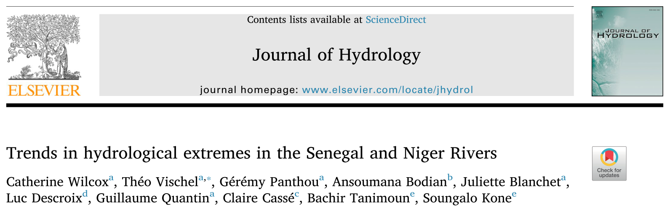
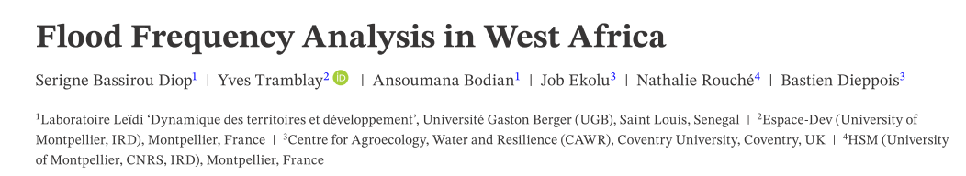

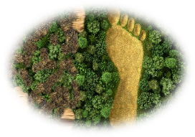
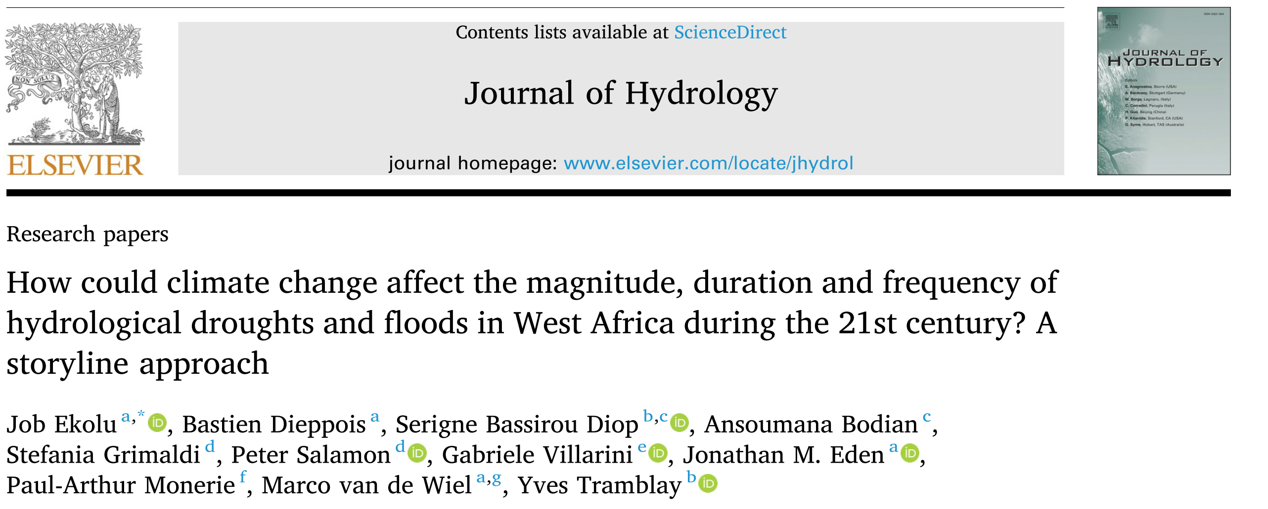
Food security
Droughts
Water ressources
Water cycle
Intensification
Flood damages
Extreme Storms
Floods

Slide 6
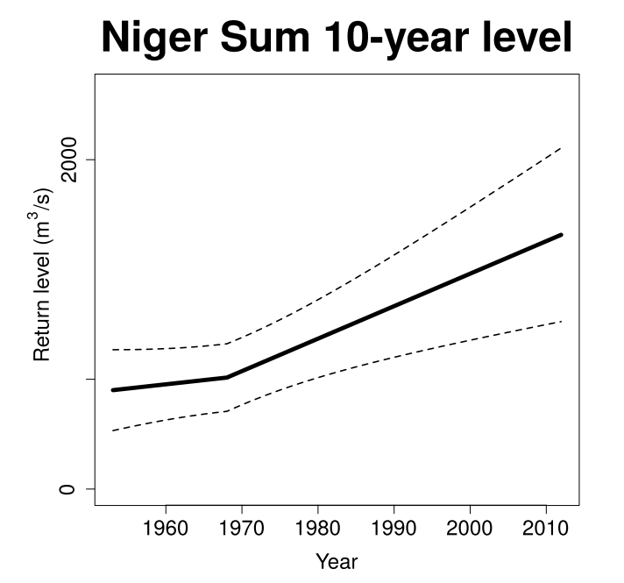
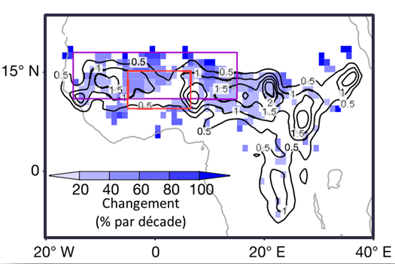
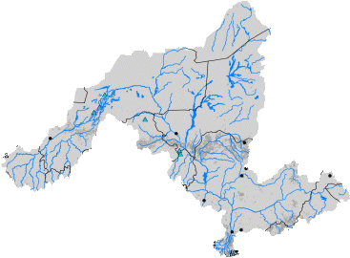

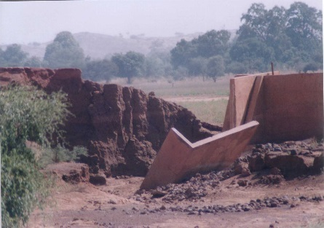
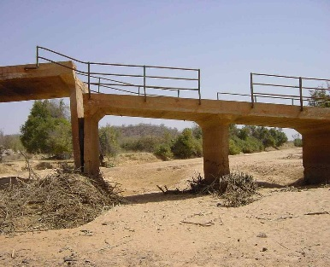
Sahelian tirbutaries
Niger River
Extreme Storms
Floods
x 2
Wilcox et al. 2018, J.Hydrol.
10-yr return levels
Hydrological
Standards defined in the 70’s
Burkina Faso (# 2000),
Courtesy J.M. Paturel
! Impact on
hydraulic structures!
Notes:
A context that challenges decision-makers and managers of hydro-climatic risks to implement appropriate adaptation strategies.

Slide 7


New hydrological norms and
practices are required
Hydrological
Standards defined in the 70’s
Burkina Faso (# 2000),
Courtesy J.M. Paturel
! Impact on
hydraulic structures!
Notes:
A context that challenges decision-makers and managers of hydro-climatic risks to implement appropriate adaptation strategies.

Slide 8
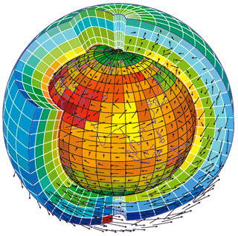
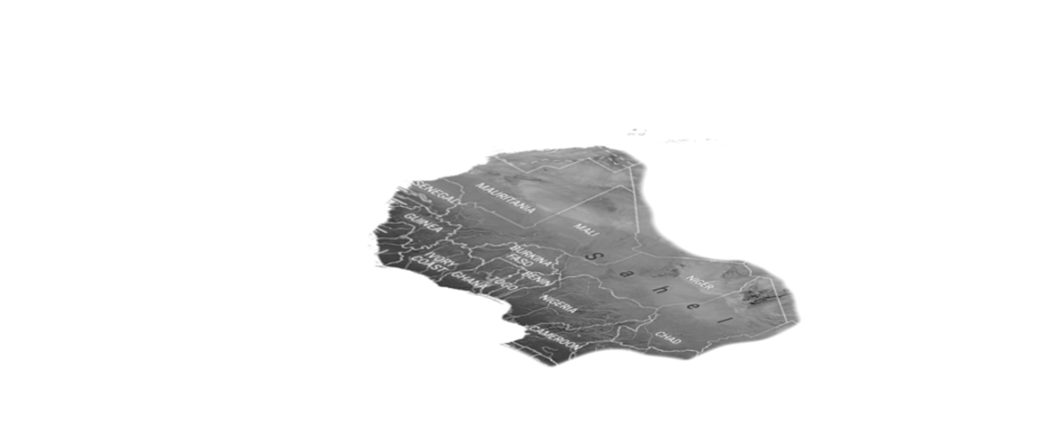
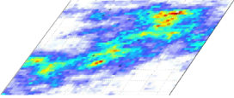

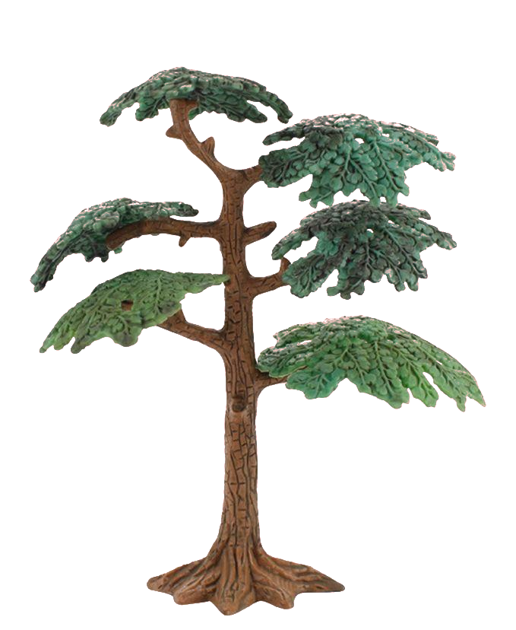

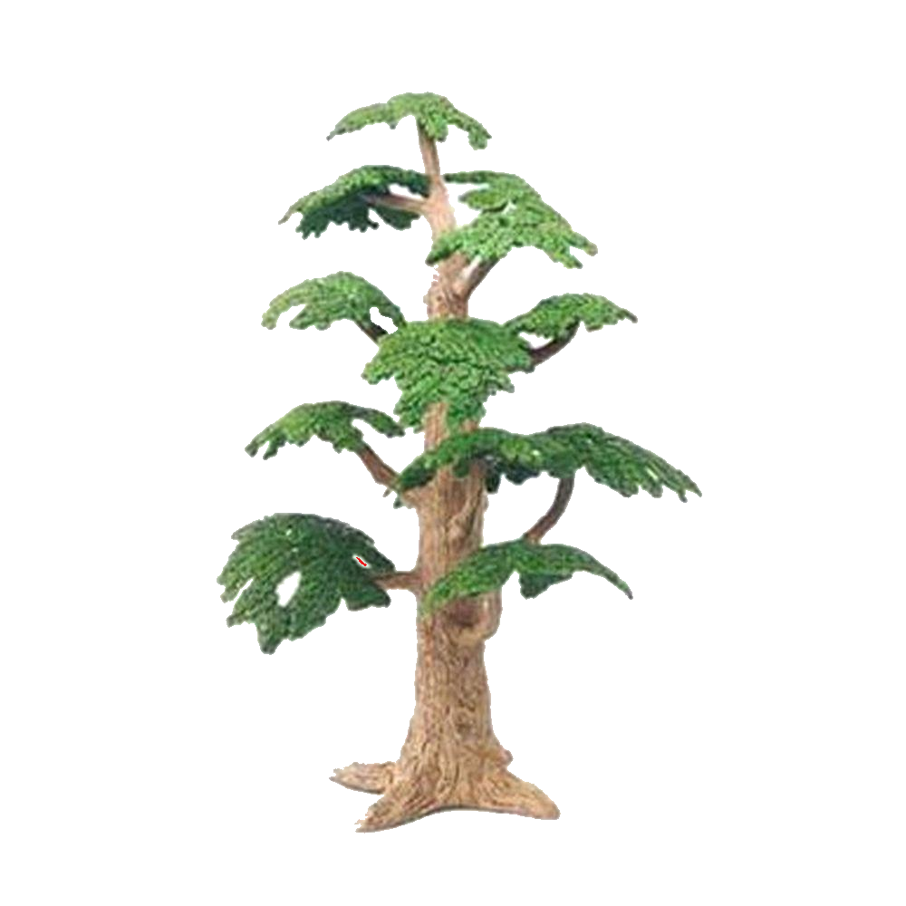
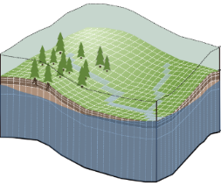
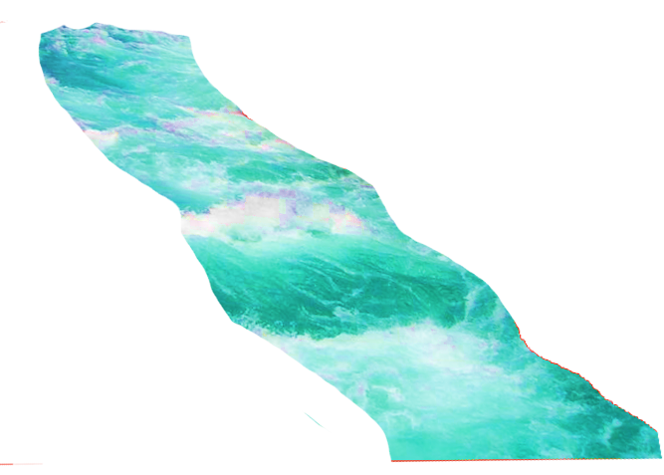

GCM
RCM
Scientific challenges
Flood prediction in a changing environment
Climate
Stochastic Rain Generator
Adaptation
Strategies
Hydrological
Modelling
Rain
Floods
Surface properties
LULCC

Slide 9

GCM
RCM
Scientific challenges
Flood prediction in a changing environment
Work to bridge the gap between scientist and decision-makers
Climate
Stochastic Rain Generator
Adaptation
Strategies
Hydrological
Modelling
Knowledge-action
Gap
Rain
Floods
Surface properties
LULCC

Slide 10


GCM
RCM
Scientific challenges
Flood prediction in a changing environment
Work to bridge the gap between complex results and decision-makers
Climate
Stochastic Rain Generator
Top – Down
Bottom-Up
Adaptation
Strategies
Hydrological
Modelling
Indicators
Co-construction
Rain
Floods
Surface properties
Useful
Usable
Used
Decision Makers
Engineers
LULCC

Slide 11
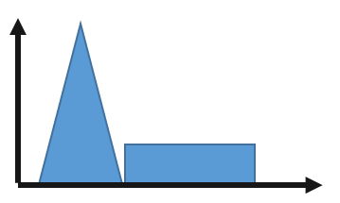
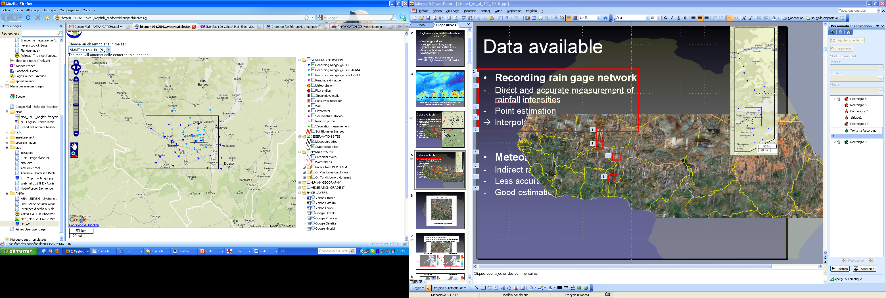


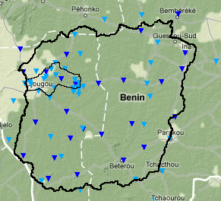


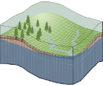

Design storms
Extreme flow
distribution
Collaboration with:
Academics
National Hydrological & Weather Services
Long term observations
Design Flood
IDF curves
GCM
RCM
Climate
Stochastic Rain Generator
Top – Down
Bottom-Up
Adaptation
Strategies
Rain
Hydrological
Modelling
Floods
Indicators
Co-construction
5-minute rainfall measurements
since 1990
Surface properties
Galle et al. 2018, VZJ
Useful
Usable
Used
Decision Makers
Engineers
LULCC

Slide 12




International Program
Gathering scientists and policy makers in West Africa to increase understanding of the regional climate apply that knowledge to practical development questions.
Burkina Faso
Notes:
It has been chosen by the consortium to work on a case study in Ouagadougou Burkina Faso. While the region is historically affected by long and intense droughts there has been a significant increase in hydrological extremes and floods over the last forty years. As in 2009 when more than 260mm of rain fell on the city causing numerous human and material damages.
The co-production process was realised in several phases.

Slide 13
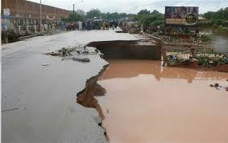
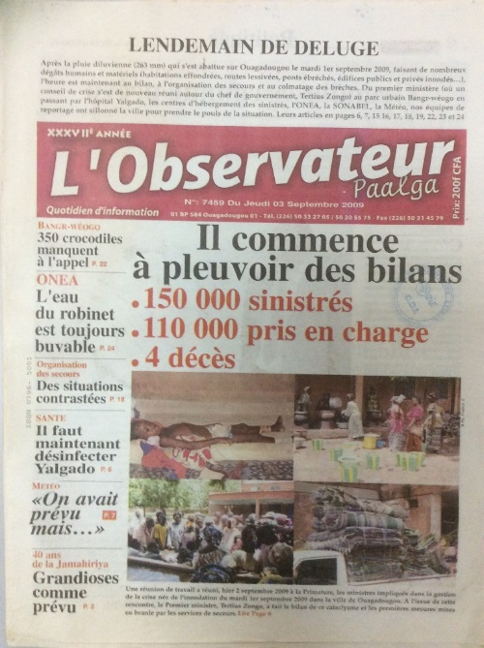
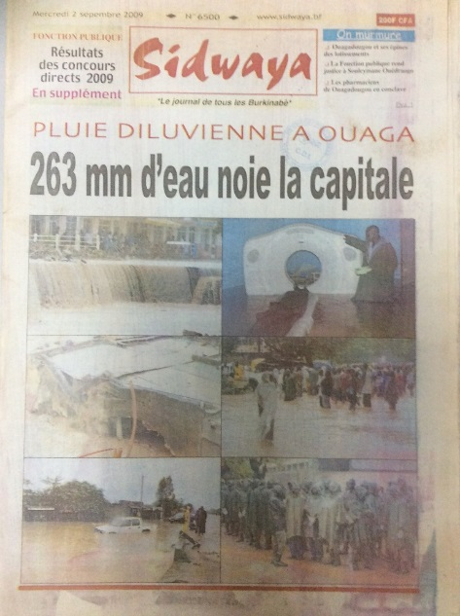


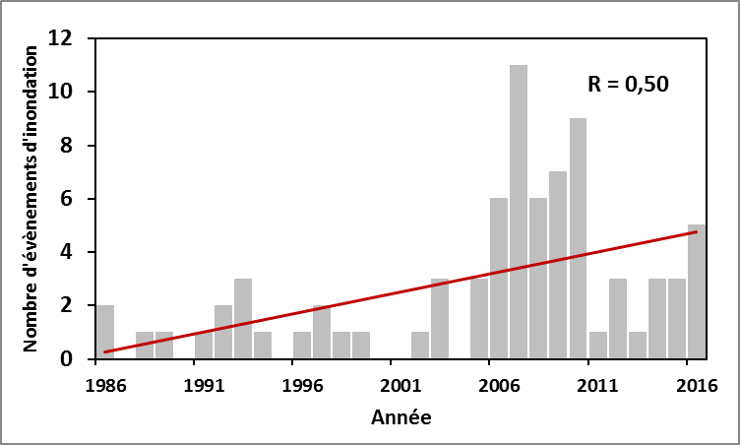
1st of Sept. 2009
International Program
Burkina Faso
Ouagadougou
Ougadougou
Municipality
Ministry of
Urbanism
How to include flood risk into urban planning?
Nb of flood events
Tazen et al. 2008, J. Flood Risk Mgmt.
Notes:
It has been chosen by the consortium to work on a case study in Ouagadougou Burkina Faso. While the region is historically affected by long and intense droughts there has been a significant increase in hydrological extremes and floods over the last forty years. As in 2009 when more than 260mm of rain fell on the city causing numerous human and material damages.
The co-production process was realised in several phases.

Slide 14

Co-production
First Phase
Two formal meetings
Climatologists and Social
scientists
Introduce the project
Top-Down
AMMA Project aims & teams
Burkinabe
scientists
Project
Head
Understand needs
Identify stakeholders
Local and national
institutions
Bottom-up
Local challenges and needs
Relevant agencies and decision makers
Ougadougou
Municipality
Ministry of
Urbanism
2016
2017
Notes:
The first phase of the process was initiated by the project leaders by approaching two local and national water management actors. Together with the Burkinabe scientists of the consortium they presented the objectives of the project. This was clearly a top-down approach, but it was also accompanied by exchanges to better identify local needs and relevant agencies and decision makers.

Slide 15


Co-production
Second Phase
Unformal meetings +
One technical workshop
6 International scientists
Communicate science and
co-develop tools
Identify decision-making issues
in flood policy and urban planning
Scientific
developments
~50 Stakeholders
Iterative process
Feedbacks
Ouagadougou Municipality
District Mayors
Technical services
Proposition of decision-support tools
Directorate of Civil Protection
Directorate of Urban Planification
National Weather Service
2016
2017
2018
Engineering companies
Notes:
The second phase was done through regular unformal meetings and one technical workshop which was important in the process and which brought together almost 50 stakeholders.
…
The objective was to initiate an iterative process to develop relevant and scientifically grounded decision support tools.

Slide 16
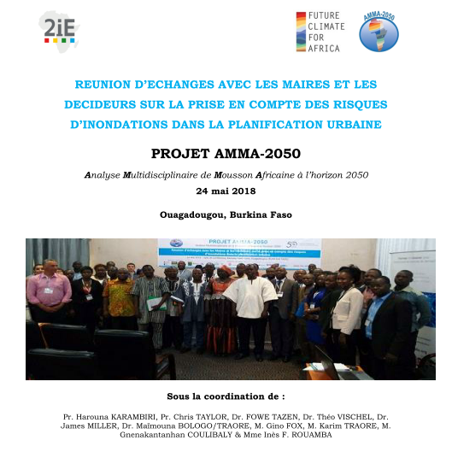


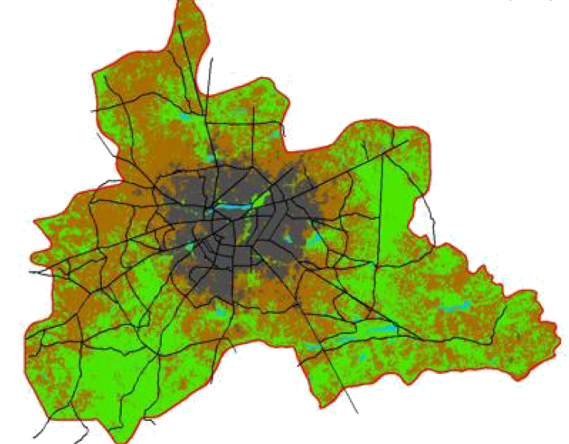
Co-production
Link btw climate change
and storm properties
Flood event
Database
« Science Café »
Is it useful?
Is it usable?
How can we make it used?
Proposition of decision-support tools
Design storms
Flood maps
2016
2017
2018
Notes:
This led us to propose 4 decision support tools :
…
Then we organised a « Science Café » animation to evaluate whether theses tools could be useful, usable and how they could be used.

Slide 17
Scientific Challenges
Design storms
How to link climate projections with extreme precipitation…
…at local scales/high resolution (<1km, <1h) compatible with hydrological modelling…
…without high resolution rainfall in-situ measurements…
..to project flood maps…
…under changing land use/cover scenarios
Climate change
Flood maps
2016
2017
2018
Notes:
The result was that design storms and flood maps were relevant decision support tools provided we know how they will evolve with climate change.
This was really interesting but also raised scientific challenges about…

Slide 18
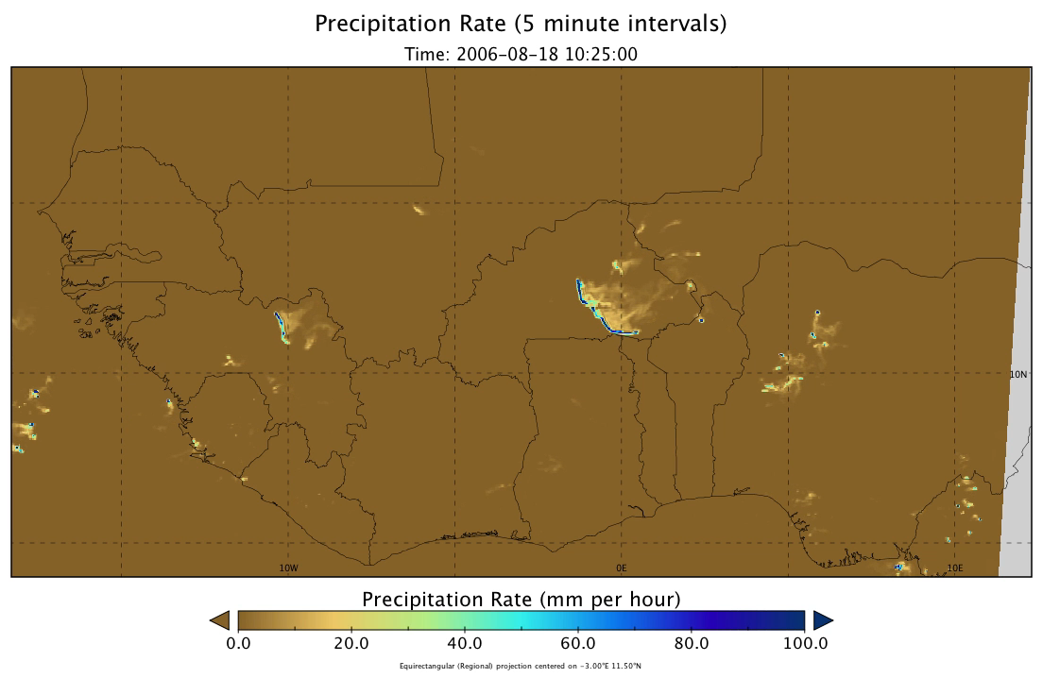
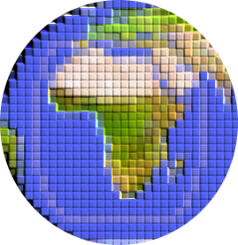
Unified GCM
Met Office
CP4-Africa
Design storms
Global climate model
Regional convection-permitting model
Stratton et al. 2018 J. Clim
Kendon et al. 2019, Nature
Berthoud et al. 2019, GRL
Senior et al. 2021, BAMS
Convection Permitting
1 hour
4 km
Simulation scheme:
10-years in control period 1997-2006
10-years future climate ~2080-2100
2016
2017
2018
2019
Notes:
I wont’ go into technical technical just to mention that made use of the freshly released climate simulations from the first ever convective permitting climate model runned in Africa due by the Met Office which was a real opportunity to understand changes in monsoon storm properties. The model has been run

Slide 19

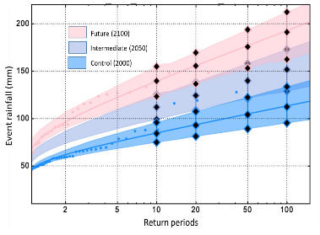
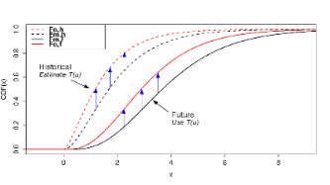


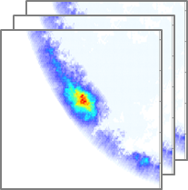
Unified GCM
Met Office
GEV distribution
CP4-Africa
Ouaga
Design storms
CDF-t
Stochastorm
Event
Global climate model
Regional convection-permitting model
Bias correction
Stochast. Rainfall
Generator
Stochast. rainfields
Event-based GEV distr.
5-min
In situ Obs.
Nearest
Event
Ouaga
2016
2017
2018
2019
Notes:
The simulations were then bias corrected and used to run a stochastic rainfall simulator for the generation of design storms.

Slide 20
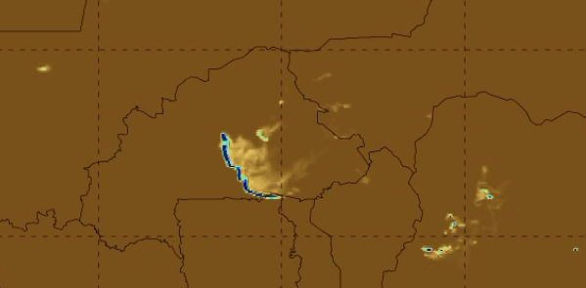

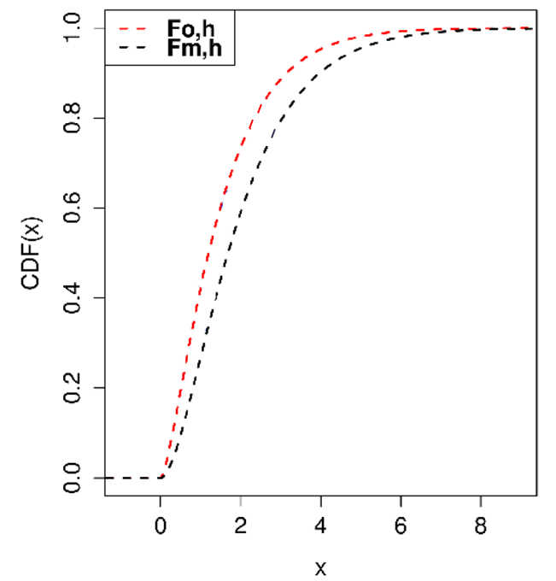
Unified GCM
Met Office
T(u)
CP4-Africa
Ouagadougou
CDF-t
Assessment
of T(u)
Global climate model
Regional convection-permitting model
Bias correction
ECDF ACN
Control period
Long term observations
In situ Obs.
ECDF CP4
Niamey
Control period
T(u)
T(u)
ECDF CP4
Ouaga
Control & future
Assumption CDF-t function T(u)
stationary in space and time
Michelangeli et al. 2009, GRL
Vrac et al. 2016, JGR
ECDF CP4
Bias corrected
Ouaga
Control & future
2016
2017
2018
2019
Notes:
The simulations were then bias corrected and used to run a stochastic rainfall simulator for the generation of design storms.

Slide 21
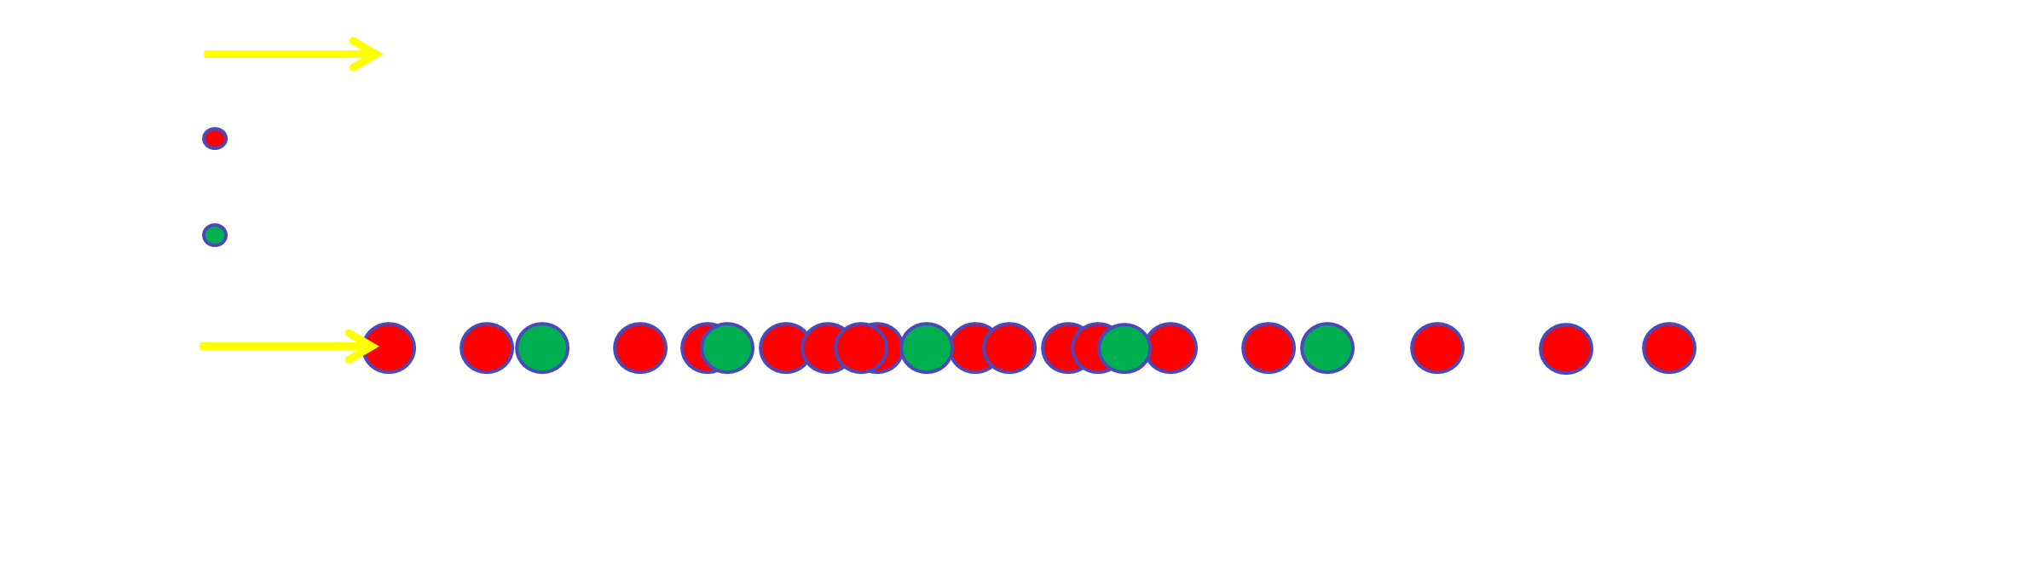




Unified GCM
Met Office
Storm Occurrence
CP4-Africa
CDF-t
Stochastorm
Storm Cumulative
Rainfall
Global climate model
Regional convection-permitting model
Bias correction
Stochast. Rainfall
Generator
Meta-Gaussian
Randomfields
In situ Obs.
Propagation
Synthetic
hyetograph
Temporal disaggregation
Vischel et al. 2009 JH, 2011 JHM
Wilcox et al 2021, JHM.
1x1km – 5minute rainfields
2016
2017
2018
2019
Notes:
The simulations were then bias corrected and used to run a stochastic rainfall simulator for the generation of design storms.

Slide 22
Unified GCM
Met Office
GEV distribution
2100
CP4-Africa
Ouaga
2050
Design storms
Present
CDF-t
Stochastorm
Event
Global climate model
Regional convection-permitting model
Bias correction
Stochast. Rainfall
Generator
Stochast. rainfields
Event-based GEV distr.
5-min
1x1 km² – 5min.
Rain Fields
In situ Obs.
Nearest
Event
Ouaga
2016
2017
2018
2019
Notes:
The simulations were then bias corrected and used to run a stochastic rainfall simulator for the generation of design storms.

Slide 23




Design storms
Return periods
10 years
100 years
Climate horizons
Present
2050
2100
Hydro-meteorological monitoring
Hydrological model
Hydraulic
model
Flood maps
Urbanisation
Land use changes
2016
2017
2018
2019
Notes:
These design storms fed into another modelling chain that also brought together the expertise of several international teams.
A final workshop was held to discuss with decision-makers which return periods and climate time horizons should be produced with the modelling chain.

Slide 24
2016
2017
2018
2019
Notes:
Decision support tools have been produced.

Slide 25



Space-time design storms
Control
2050
2100
2016
2017
2018
2019

Slide 26

Land use/cover changes
1986-Control
2016-Control
2050-2100
2016
2017
2018
2019

Slide 27

Flood maps
10-yr return period
100-yr return period
Control
2050
2100
2016
2017
2018
2019

Slide 28

Co-production
2016
2017
2018
2019
2020
Notes:
But something happened that greatly limited the co-production process.

Slide 29


2016
2017
2018
2019
2020

Slide 30
Co-production
2016
2017
2018
2019
2020
2021
Notes:
Fortunately, in 2021, the Burkinabe scientists were able to organise a restitution workshop.

Slide 31

Restitution workshop
Presentation & Transfer
2016
2017
2018
2019
2020
2021
Notes:
The products were presented and some of them as design storms were transfered to the National Weather Service.

Slide 32
Restitution workshop
Presentation & Transfer
Key Messages to decision-makers
Projected increases in rainfall intensity will be a driver of increased flood risk without suitable adaptation and planning
Spatial planning measures should focus on limiting development in flood prone areas
Development of currently undeveloped areas will increase flood risk and protection should be a priority
Existing hydraulic infrastructures should be re-evaluated with respect to future flood risks
Climate change science in the region is rapidly developing and can provide support in developing policies for climate change adaptation
2016
2017
2018
2019
2020
2021
Notes:
Key messages were delivered to decision makers. If you read it you will probably find them very basic like « ».
But these messages are in fact solid because they are supported by scientific results to which the decision-makers have contributed.

Slide 33

Restitution workshop
Limitations
Technical
Only one single realisation of future climate based on one single climate model under one GHG emission scenario
Modelling chain uncertainty (scale issues, bias correction, hydrological/hydraulic modelling) was not provided
Co-production
AMMA2050 project ended in 2021 limiting the possibility to pursue the engagement with local and national decision-makers
No appropriation of the modelling chain (innovation implies handling complex scientific tools)
2016
2017
2018
2019
2020
2021
Notes:
There are also clearly limitations to the process.
Firstly technical
But also around the co-production process.

Slide 34




No appropriation of the modelling chain (innovation implies handling complex scientific tools)
A training in IDF curves built by a team of experts in extreme rainfall analysis in West Africa
Empowerment of stakeholders in advanced hydrologic engineering tools
Academics
NWS
Engineers
One trainee became trainer
2016
2017
2018
2020
2021
2022
2023
2024
2025
2026
Notes:
Based on this experience, we became aware of the necessary empowerment of stakeholders in hydrological engineering tools to enable them to leverage scientific information.
Since 2022, we are working on the CECC project, within which we are developing a research axis dedicated to training on statistical analysis of rainfall extremes for operational hydrology.
We have built a team of experts with researchers from Benin, Niger, Burkina Faso, and Senegal, who will conduct a first training session on this topic in Dakar next May.

Slide 35

Miller et al. 2022 Reg. Env. Ch.
Co-production
Notes:
There are also clearly limitations to the process.
Firstly technical
But also around the co-production process.

Slide 36


Event occurrence
Event stochastic
rainfield
Meta-Gaussian
Fields
Synthetic
hyetograph
Temporal
disaggregation
Propagation
StochaStorm
Sub-event rainfield
Wilcox et al 2021, J. of. Hydromet.

