Slide 1
Stochastic Weather Generation at High Spatial Resolution Informed by Convection-Permitting Modeling
Petr Vohnicky¹
Eleonora Dallan¹
Francesco Marra²
Nadav Peleg^{3,4}
Marco Borga¹
¹ Department of Land, Environment, Agriculture and Forestry, University of Padova – Italy
² Department of Geosciences, University of Padova – Italy
³ Institute of Earth Surface Dynamics, University of Lausanne – Switzerland
⁴ Expertise Center for Climate Extremes, University of Lausanne – Switzerland

Slide 2
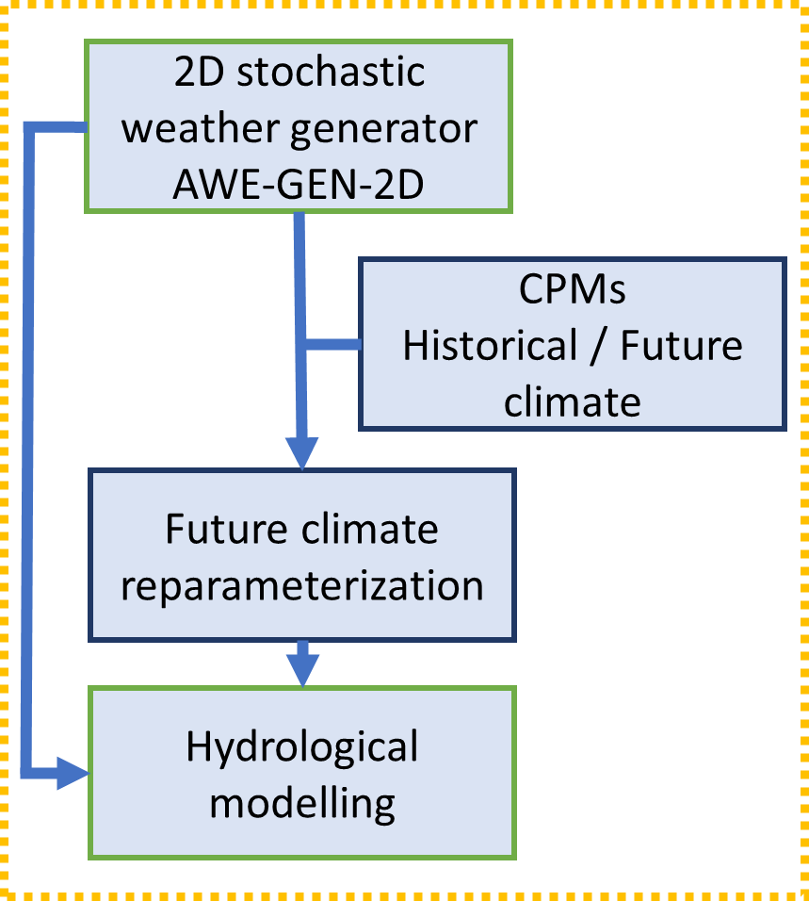
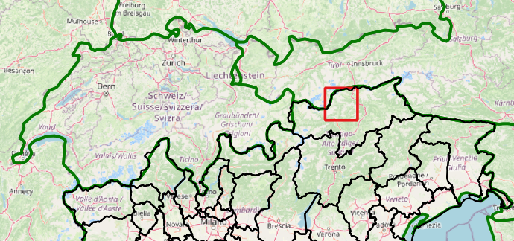
Motivation
Known issues:
Convection-permitting climate models (CPMs) have too short timeseries (usually 10 years)
Bias in CPMs precipitation
→ This limits the usability for hydrological simulations
Main objective:
Simulate Precipitation + Temperature based on CPMs to extend their time range in hourly resolution
Understanding future hydrological changes through high-resolution stochastic weather generation informed by convection-permitting models

Slide 3
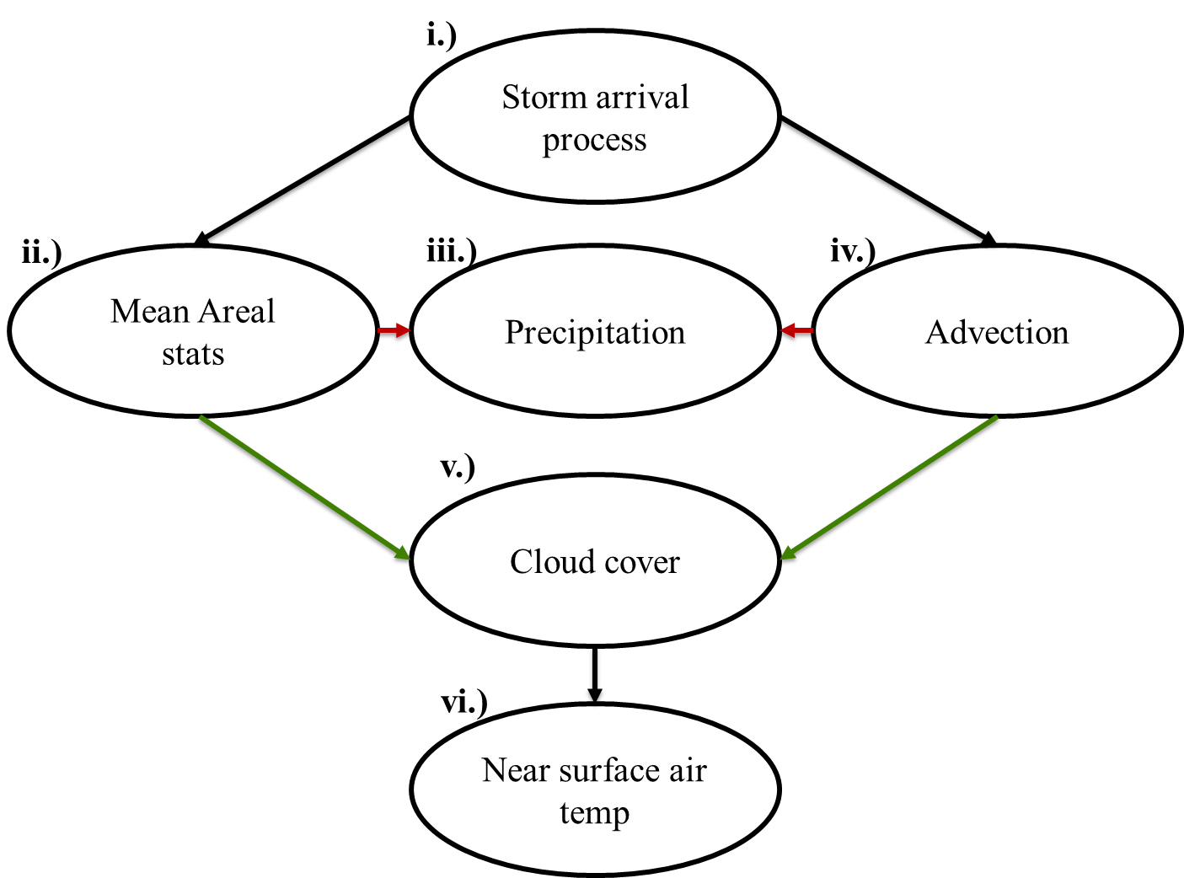
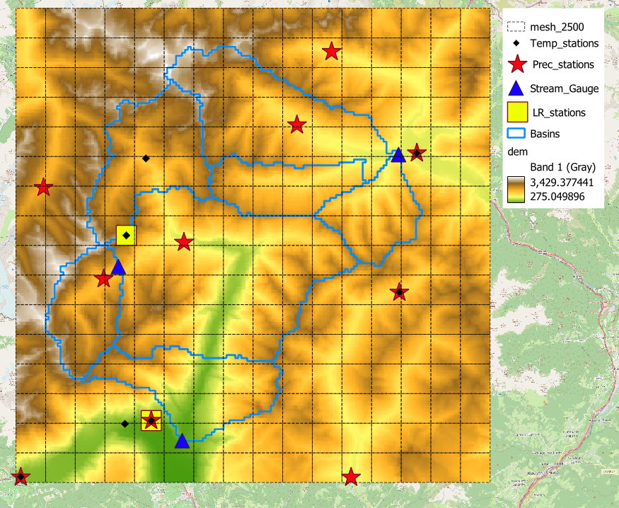
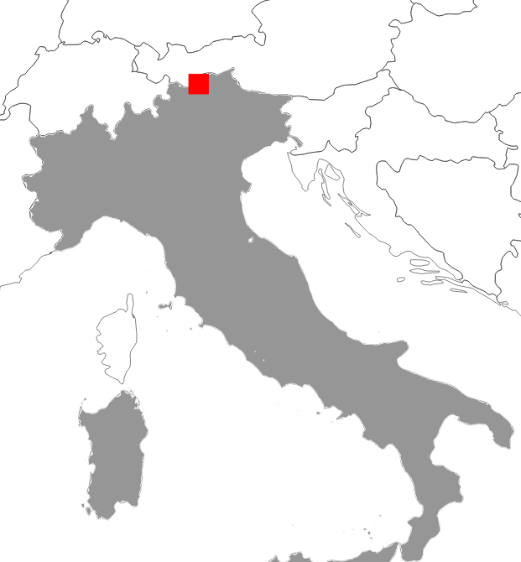
Methodology (Calibration)
AWE-GEN-2D:
Semi-distributed Hydrological model: ICHYMOD (v1.1)
A) Rio Plan (49.0 km²)
KGE (Kling–Gupta Efficiency): 0.813
bias : 0.963
B) Rio Passirio at Merano (414 km²)
KGE (Kling–Gupta Efficiency): 0.697
bias : 0.971
C) Rio Ridanna at Vipiteno (210.2 km²)
KGE (Kling–Gupta Efficiency): 0.830
bias : 0.971
ii.)
Mean areal precipitation
Wet area ratio
Spatial correlation CV
Observed occurrence
iii)
Bias correction on intensities
(Calibrated on 1996-2023)
“Precipitation 2000-2021 grid”
We do not have grid hourly precipitation data.
We interpolate to grid scale by multiquadratic surface fitting
(Borga & Vizzaccaro 1997)
C)
Setup AWEGEN-2D:
2.5 km grid; 16 x 16 grid domain
Precipitation: 12 YEARS where all 10 precipitation stations has data (various years 2005-2020)
Temperature: 2004 to 2021
Cloud Cover (ERA5) : 2004 to 2021
Wind speed at 500 hPa (ERA5) : 2004 to 2021
A)
B)

Slide 4
Methodology (Climate model and Setup)
ETH model from CORDEX FPS-Convection
COSMO-crCLIM 2.2km (GCM MPI-ESM-LR)
Precipitation and Temperature at 1h resolution
Historical and RCP8.5 scenario 2090-2099 far future period
With AWE-GEN-2D we generate two scenarios:
Precipitation does NOT change and only Temperature will increase
Precipitation and Temperature will increase

Slide 5
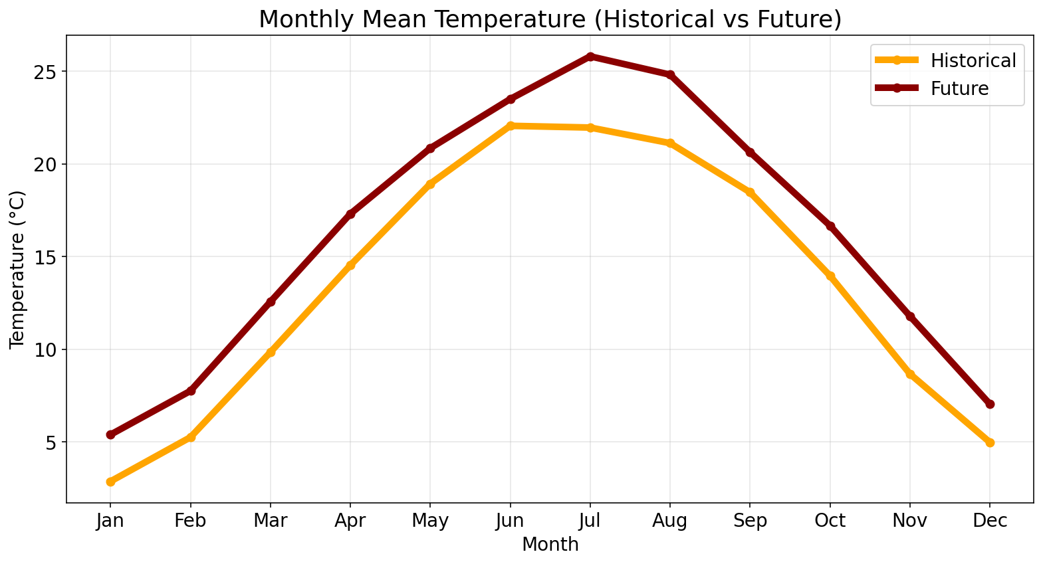
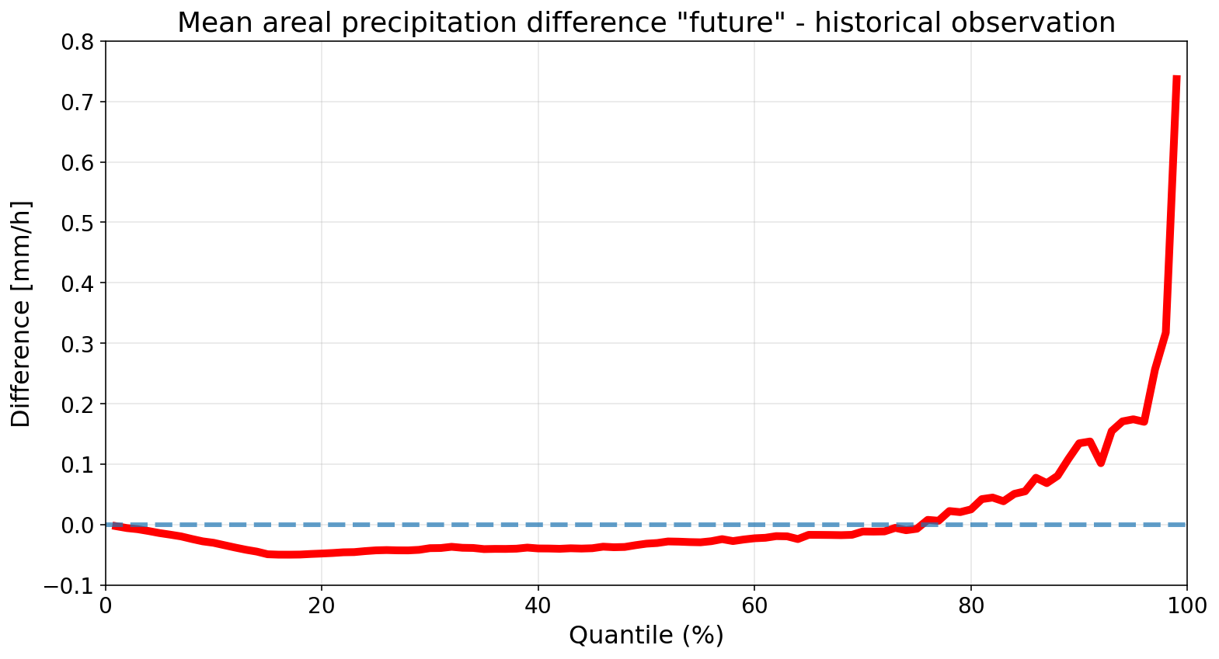
Reparameterization by CPM (ETH)
Factorial of change:
Temperature (additive) (+2 W to +4 S °C)
IMF (QM to future)
Spatial CV (-5% W to +16% S)
WAR (+12% W to -17% S)
Intensities on grid (QM to future)
What we did not change:
OCC (Probability of occurrence)
Dry and Wet spells

Slide 6
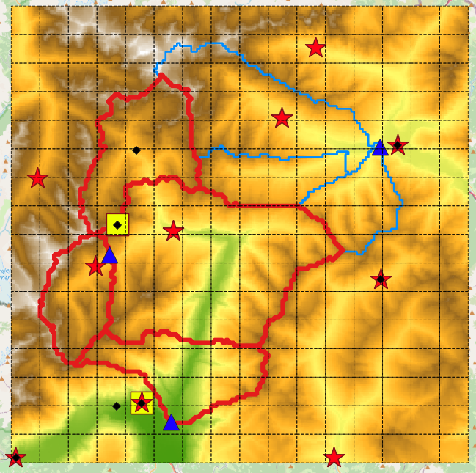
Results – Hydrological model
Rio Passirio at Merano
(414 km²)
B)

Slide 7
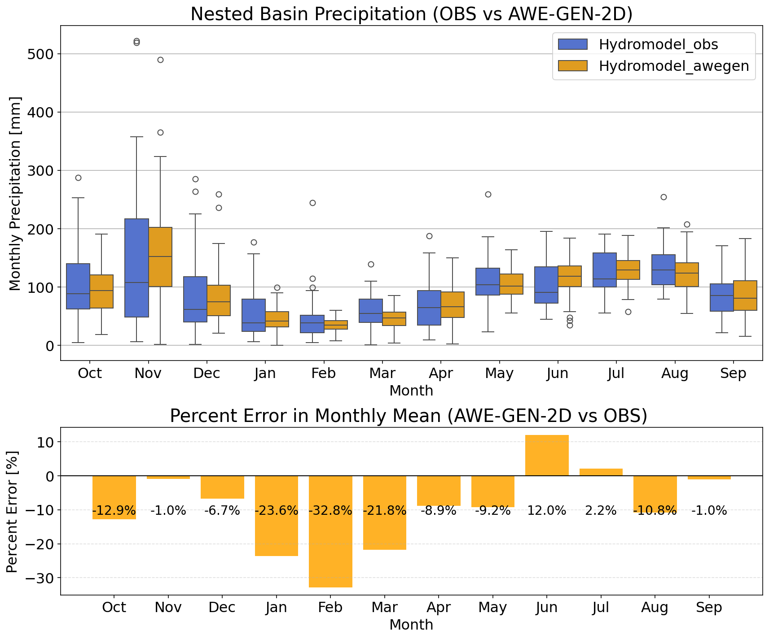
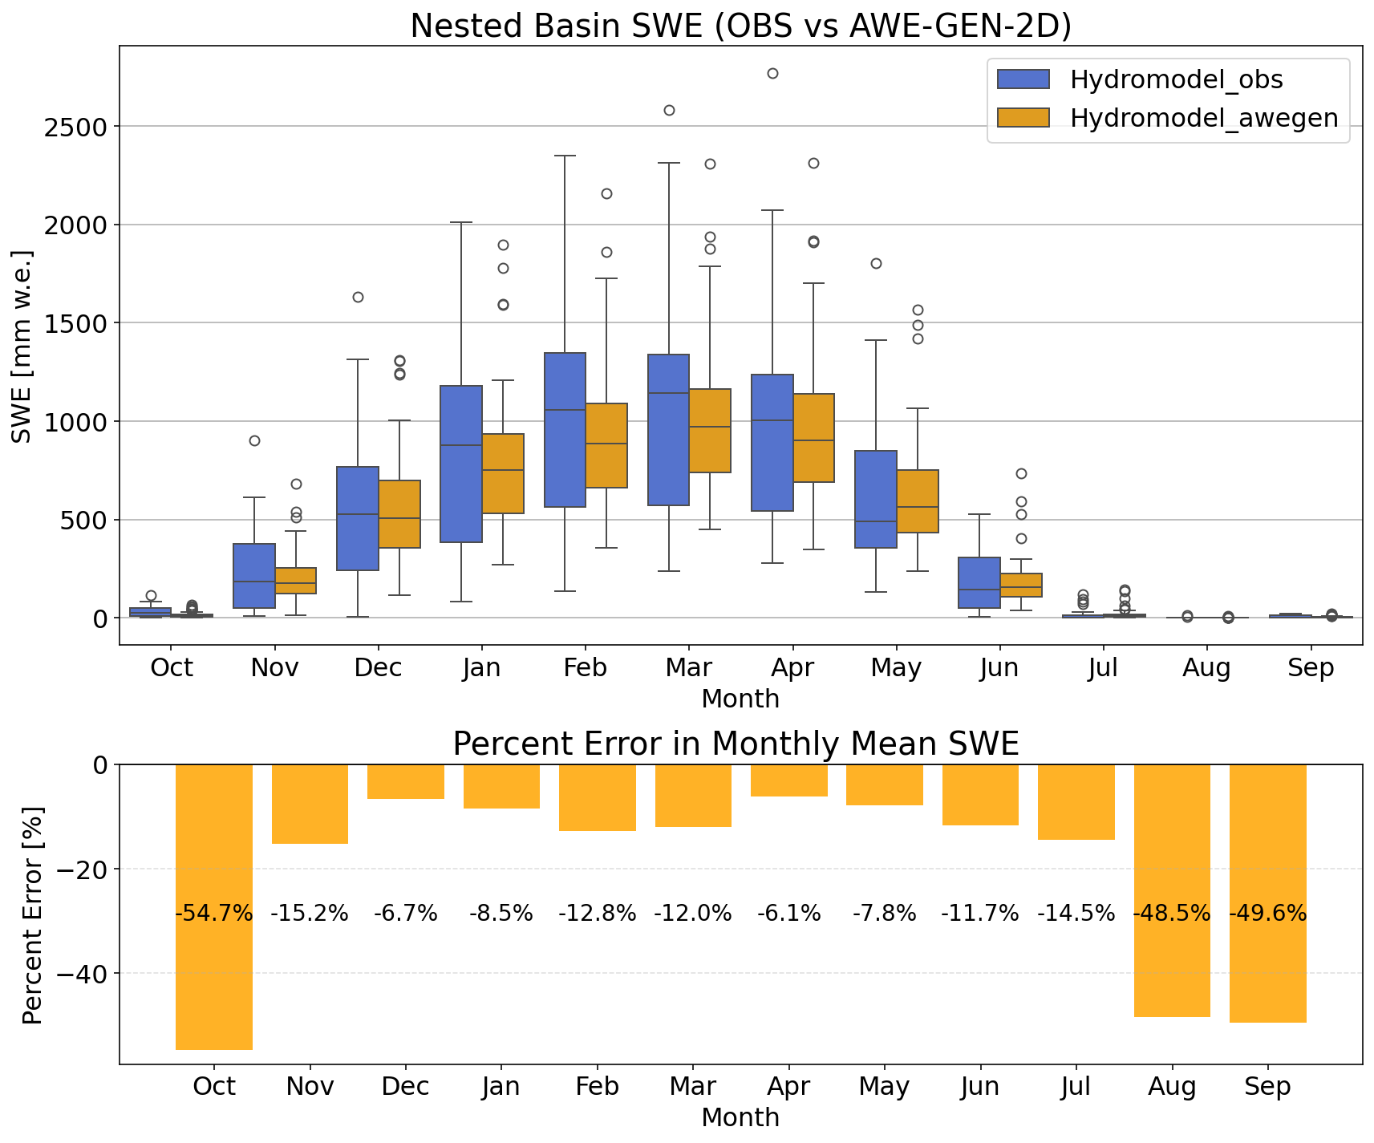
Results – Calibration precipitation
Synthetic data precipitation close to observation
Snow regimes close to observation

Slide 8
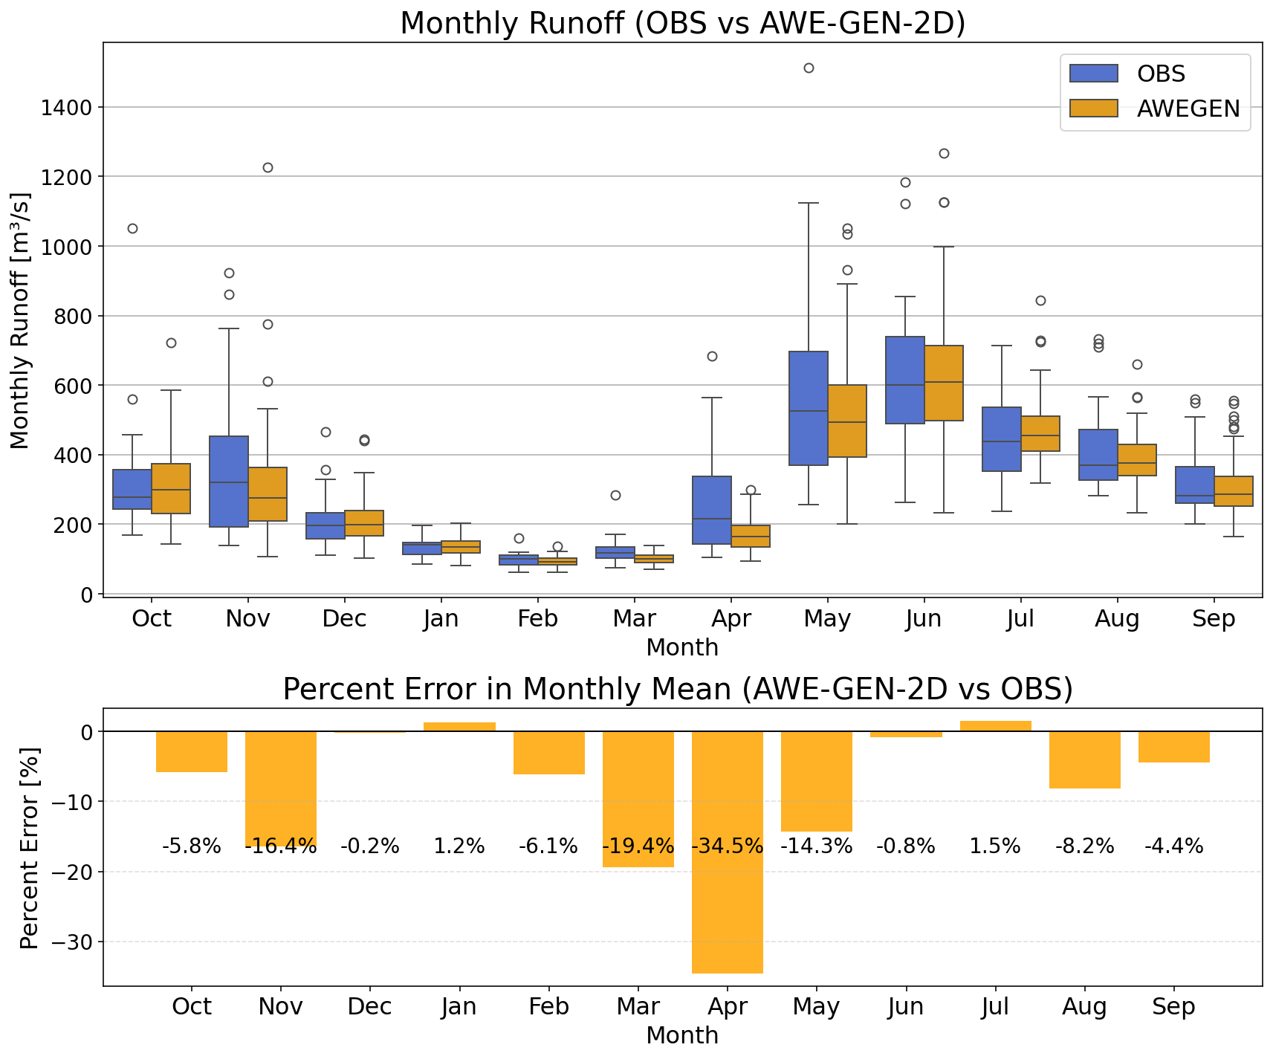
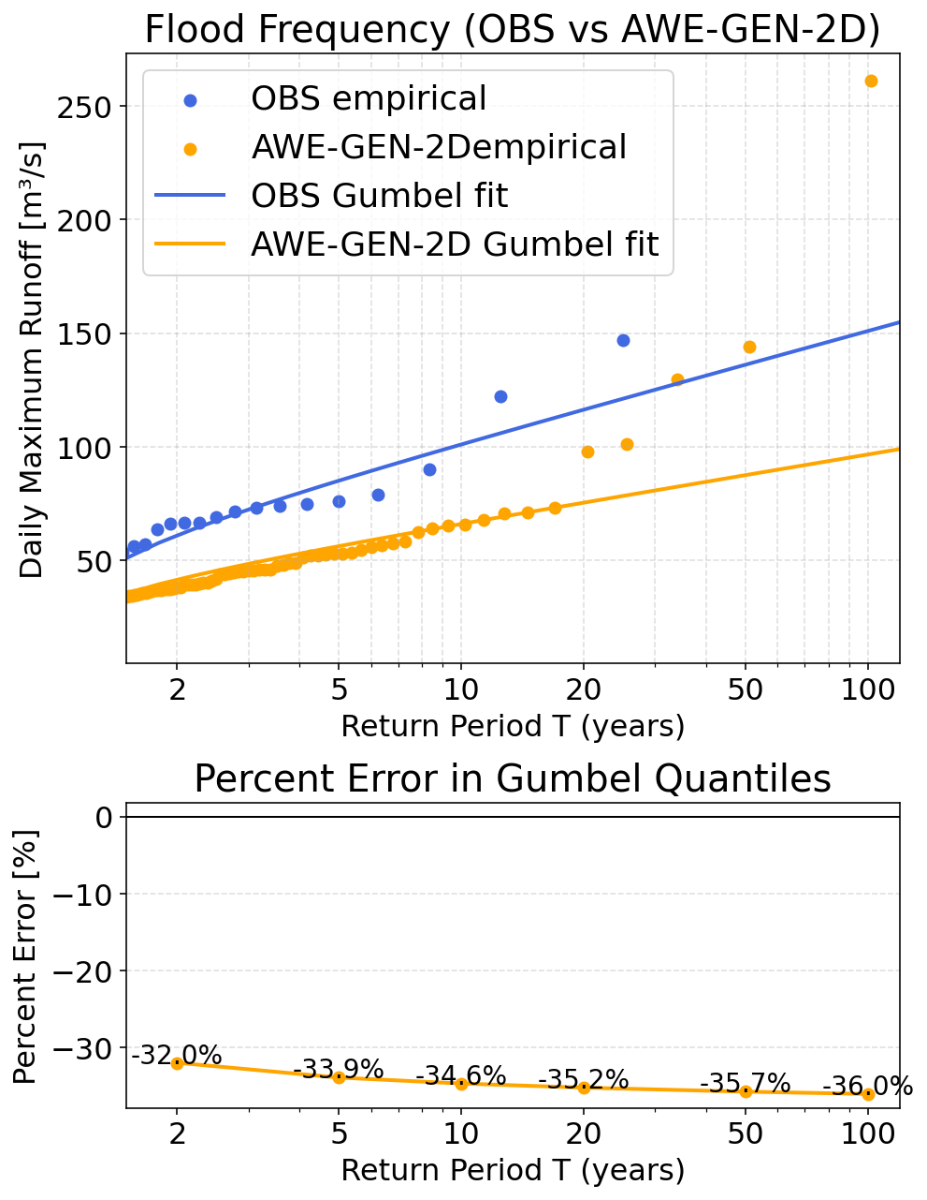
Results – Calibration runoff
Synthetic data runoff close to observation
Underestimation of floods

Slide 9
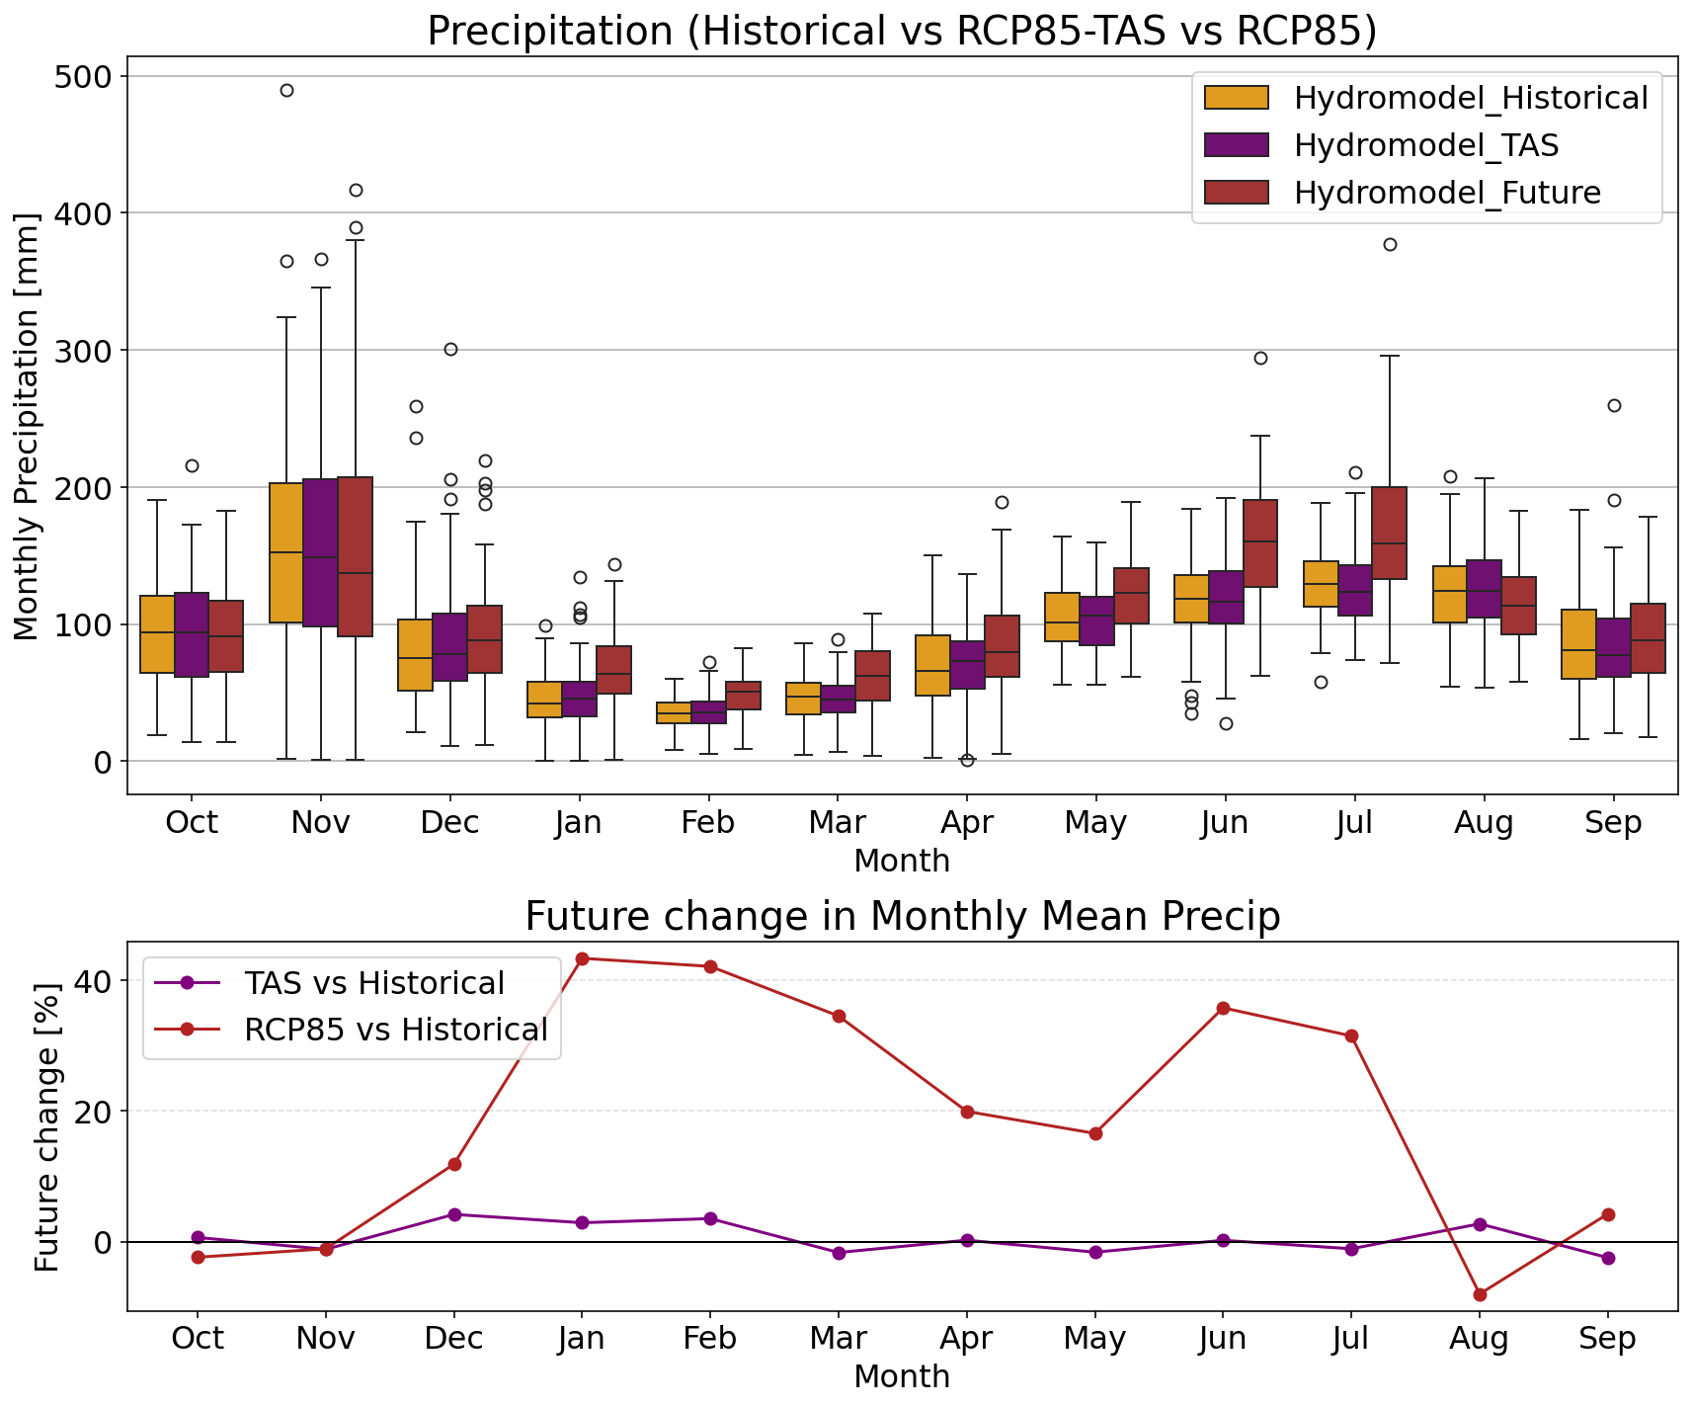
Results – Future change precipitation
Monthly precipitation increased mostly during the summer

Slide 10
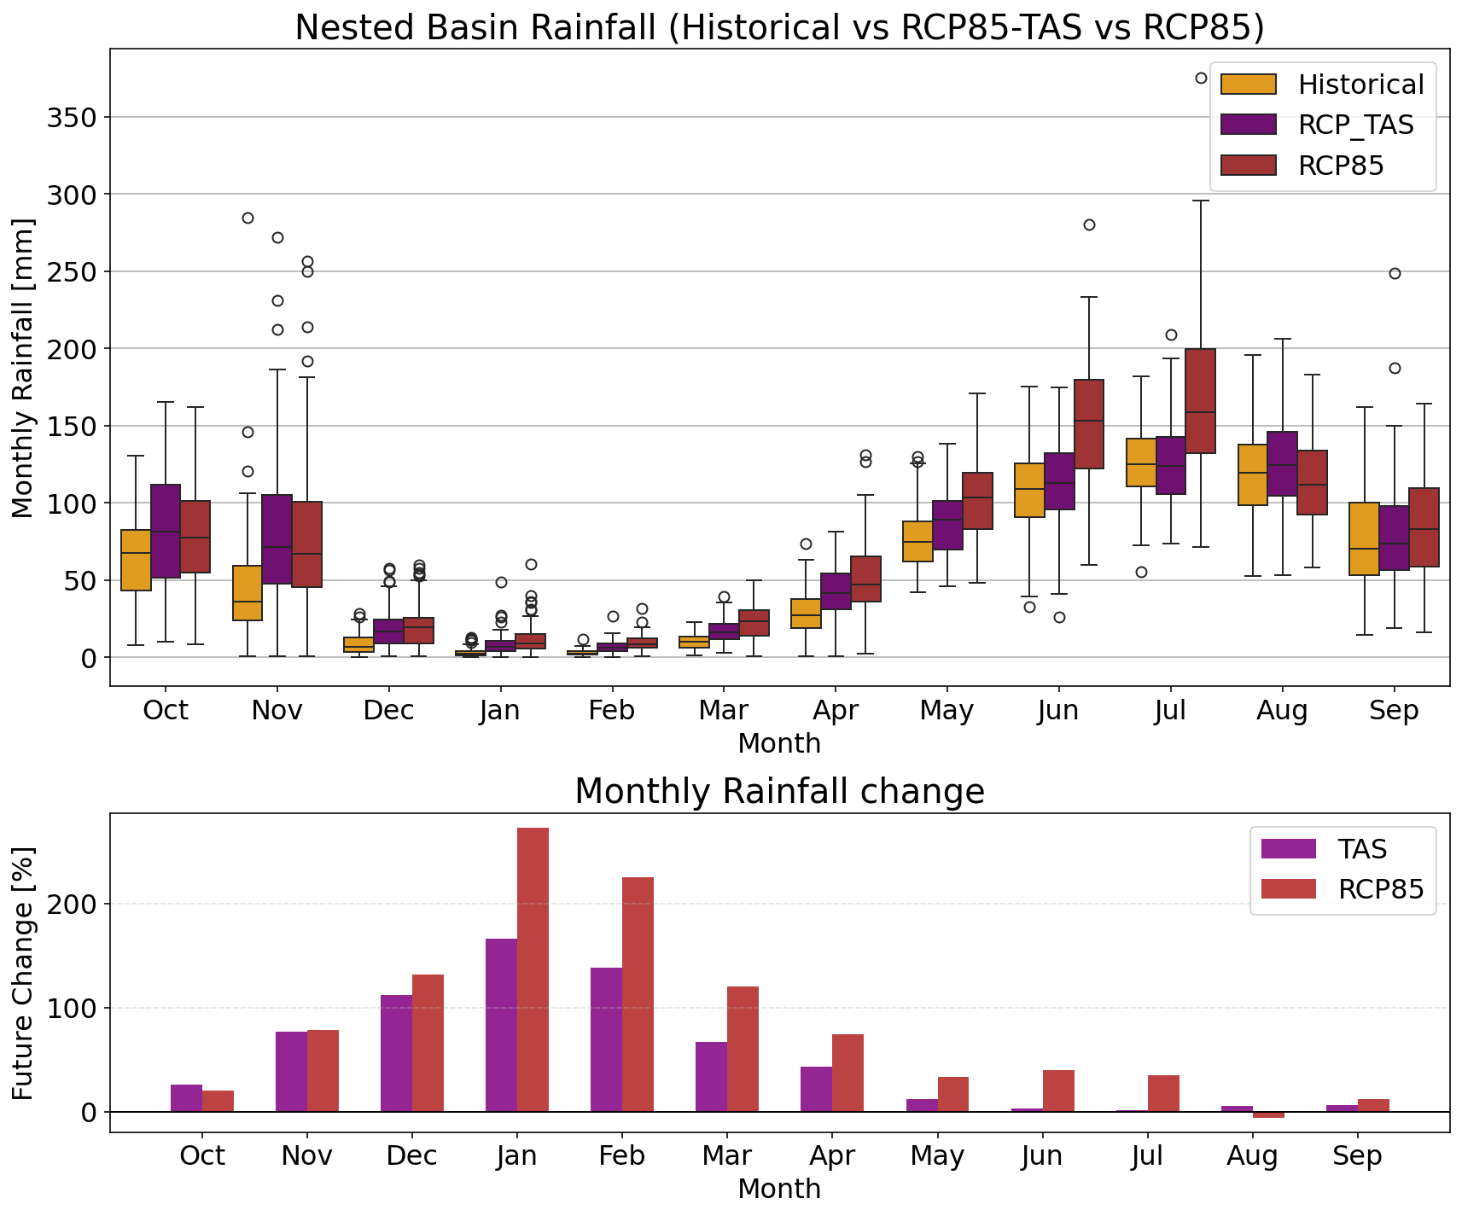
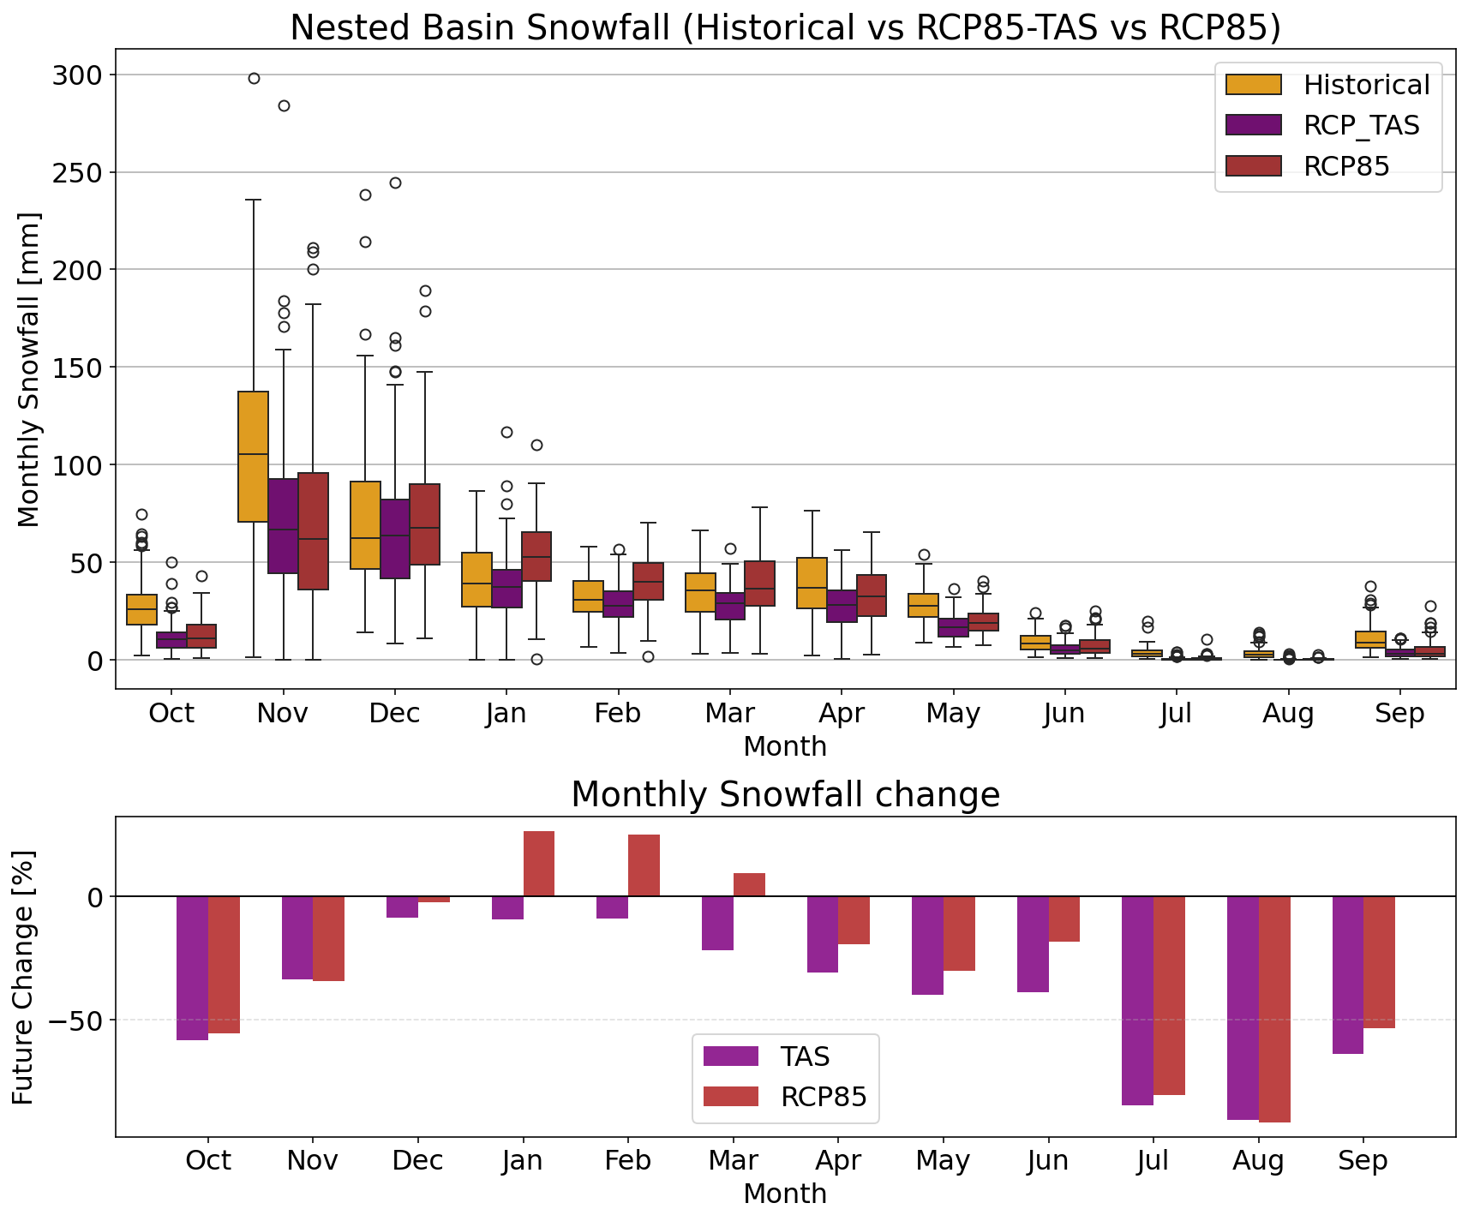
Results – Future change rain vs snow
Rainfall increase
Snow decrease

Slide 11
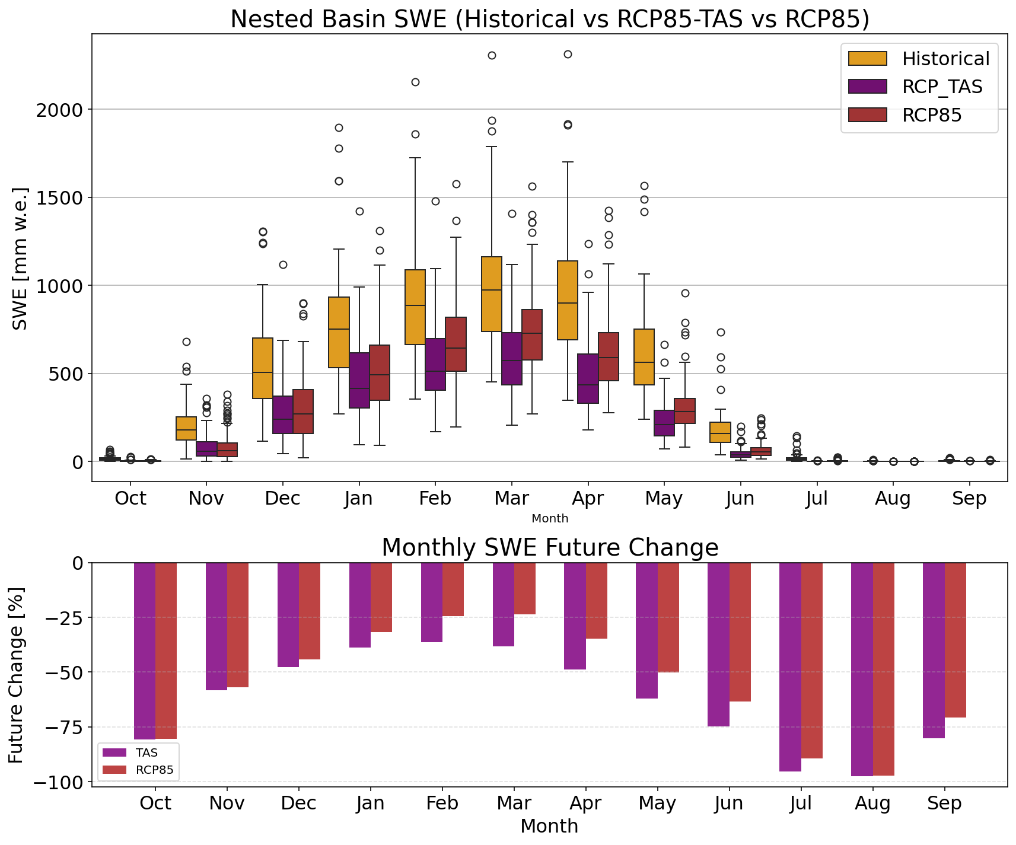
Results – Future SWE
Large decrease in the snow water equivalent

Slide 12
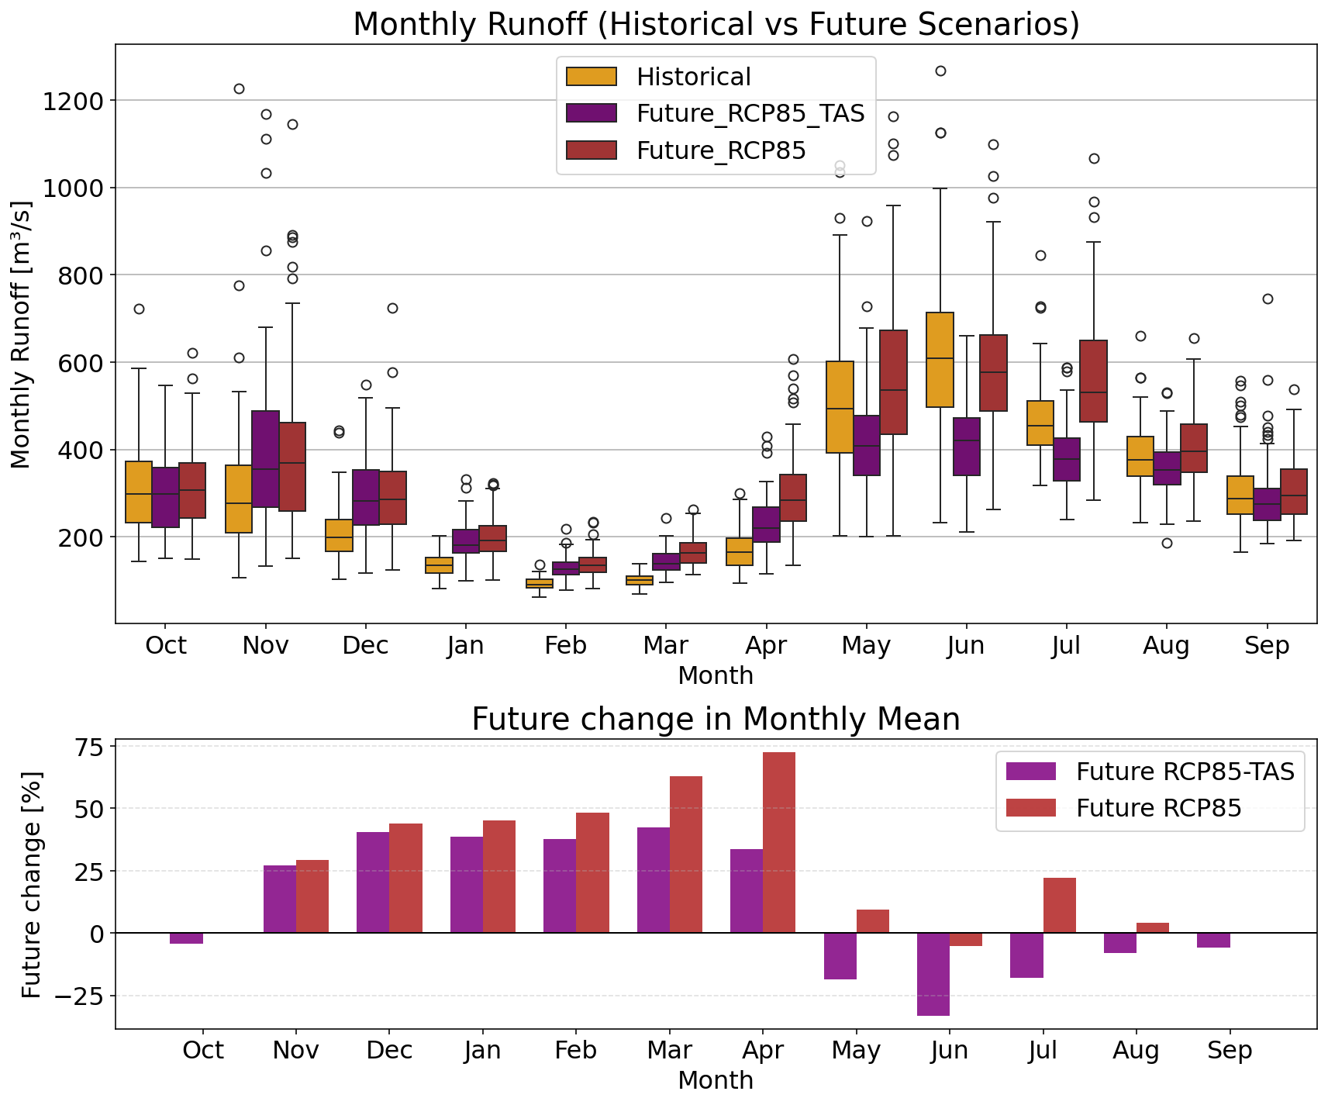
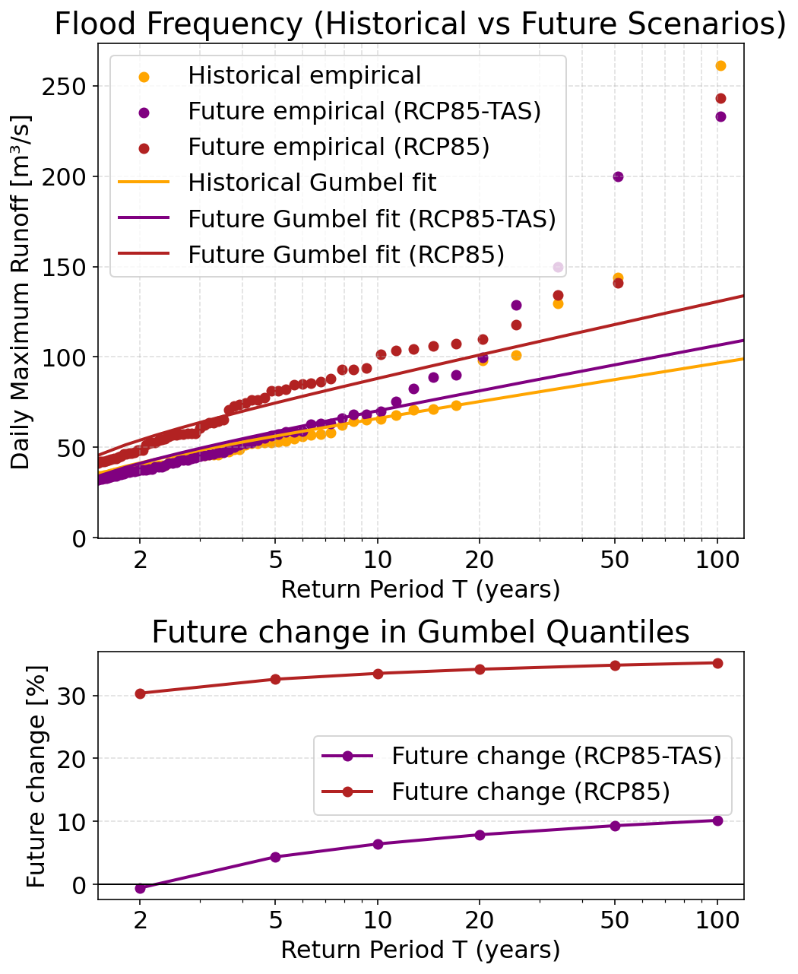
Results – Future change Runoff
Higher winter runoff
Increase of floods in RCP85 but not due to temperature

Slide 13
Conclusion
With synthetic weather from AWE-GEN-2D, we were able to simulate seasonal runoff statistics close to the observation
but not so good extremes flood statistics
Under RCP85 (factors of changes from ETH-CPM):
Temperature increase influence the winter season runoff but not floods. (Only higher quantiles had small increase)
Overall precipitation increase “compensate” for the temperature increase in the seasonal runoff especially during the summer
Increase in mostly summer extremes positively influenced the flood generation
What’s next?
Extend analysis with more CPM models and longer timeseries of synthetic data.

Slide 14

Stochastic Weather Generation at High Spatial Resolution Informed by Convection-Permitting Modeling
Thank you for your attention.
The research leading to these results has received funding from the European Union's Horizon 2020 Research and Innovation Programme under the Marie Skłodowska-Curie Grant Agreement No 101034319 and from the European Union – NextGenerationEU.

